Slide 1
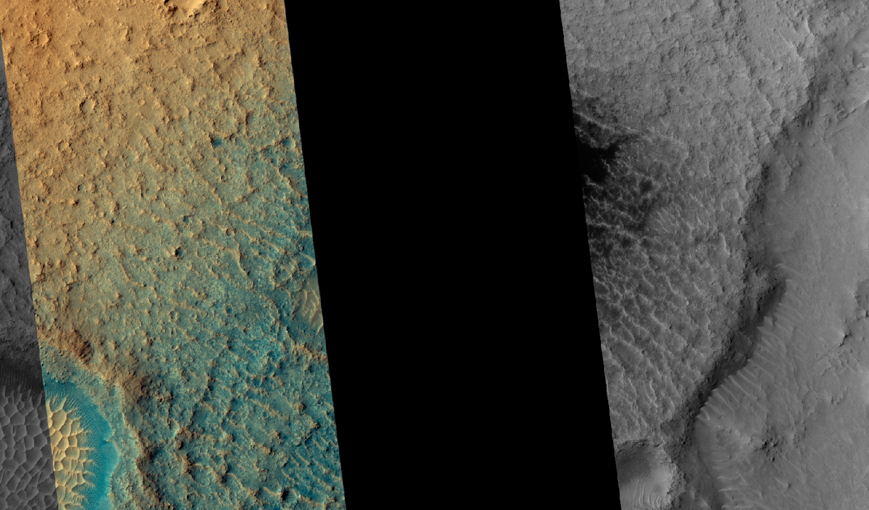
Updating science operations planning software for the sudden loss of capacity in the HiRISE CCD array
Nicole Baugh
Audrie Fennema, Guy McArthur, Christian Schaller
Nicole Bardabelias, Kristin Block, Veronica Bray-Durfey, Singleton Papendick, Jason Perry
Lunar and Planetary Laboratory, The University of Arizona

Slide 2
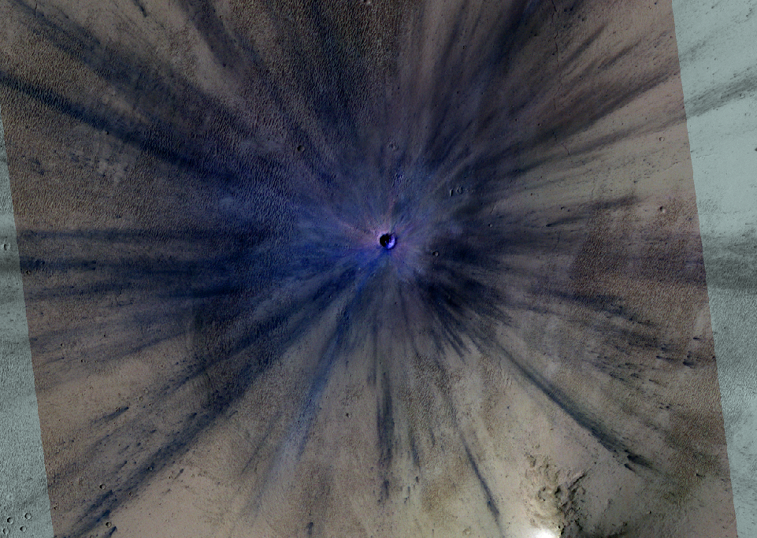
Outline
MRO
HiRISE
JMARS
HiPlan/HiCommand
HiRISE CCD anomalies
Addressing the RED4 anomaly
Summary
ESP_034285_1835

Slide 3
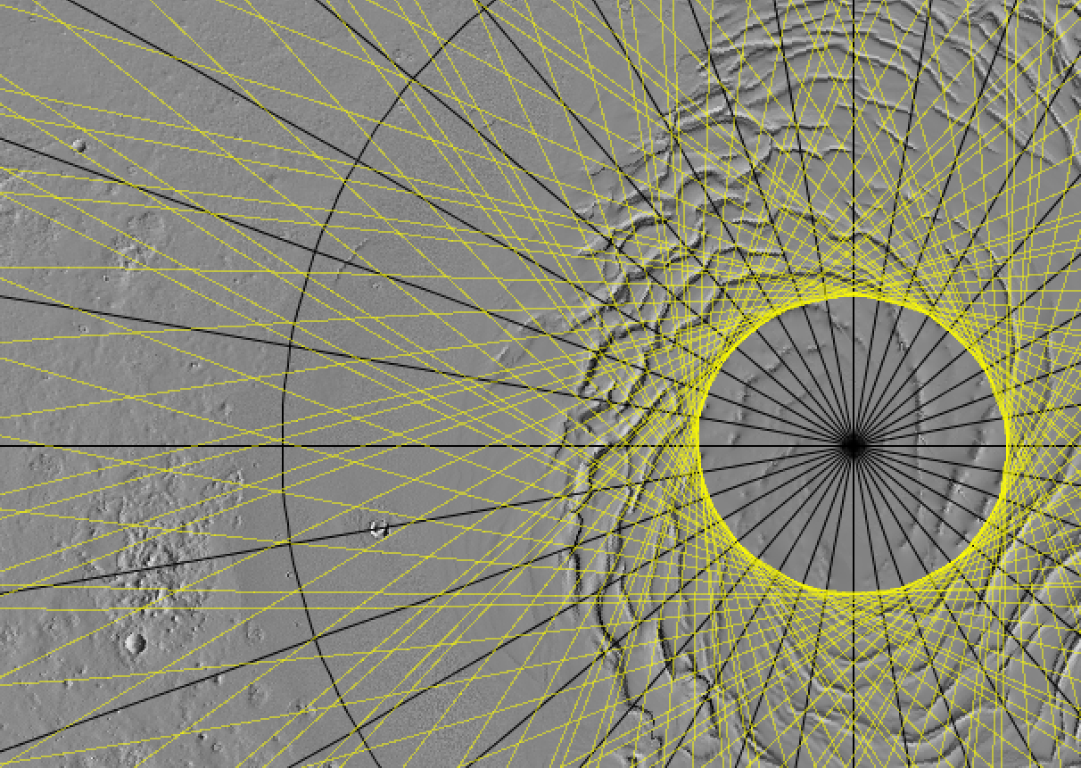
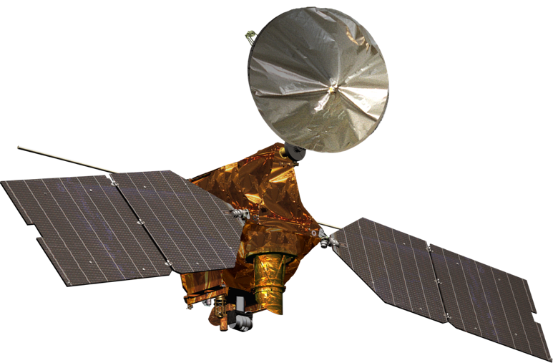
MRO
NASA
HiRISE
Launched in 2005, MOI 2006
mars.nasa.gov/mro
6 science instruments
Near-polar orbit, off-nadir rolls of up to 30°
Targets planned in 2-week sequences
NAIF SPICE for navigation and observation geometry
naif.jpl.nasa.gov
Notes:
Intro state files, very briefly.

Slide 4
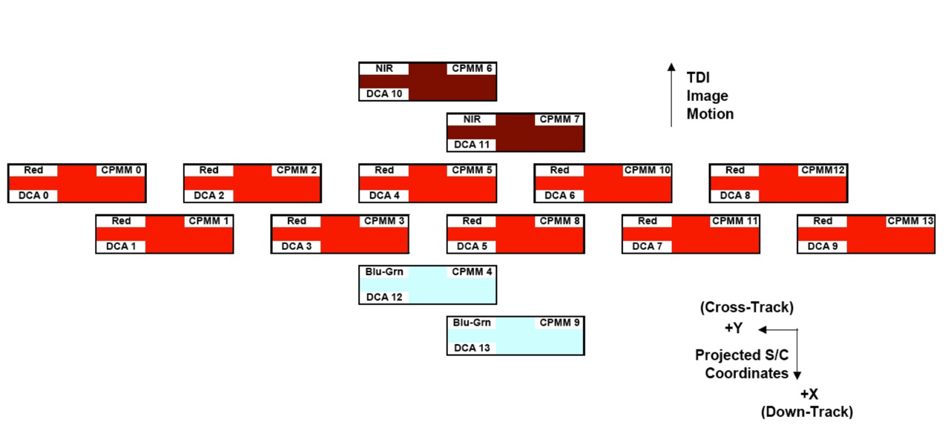
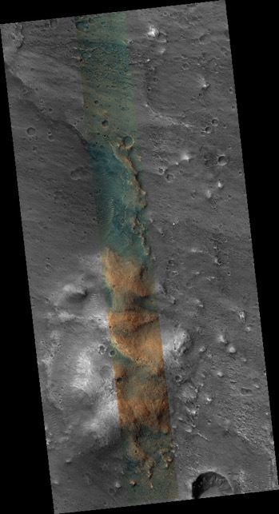
HiRISE
Pushbroom detector
Ground scale 30 cm/px
Swath width: 6 km (1.2 km color)
uahirise.org
ESP_069736_2060

Slide 5
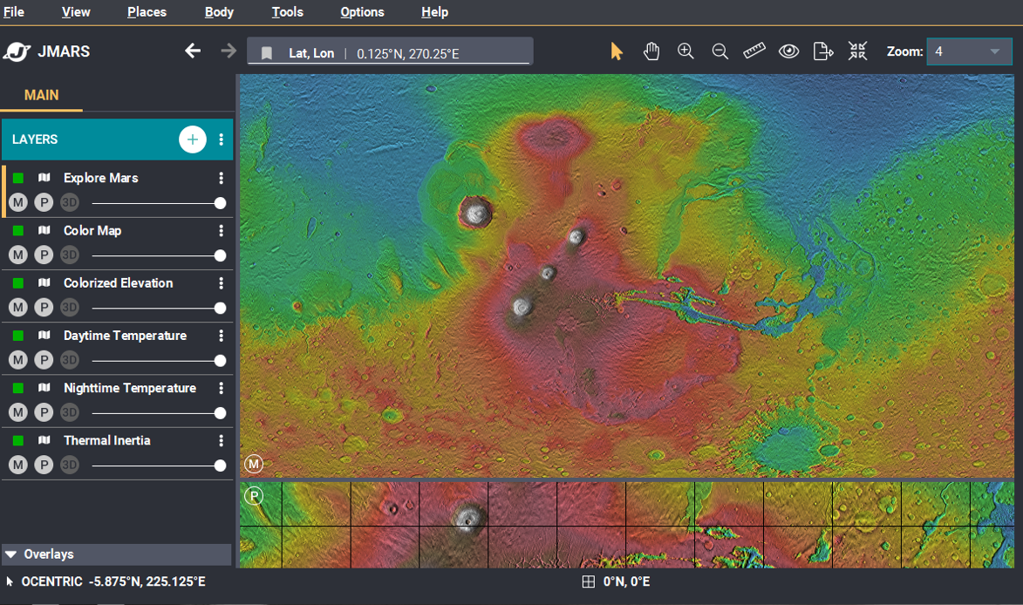
JMARS
Java Mission-planning and Analysis for Remote Sensing
GIS developed at ASU initially for Mars, now for many more solar system bodies
Used by MRO, OSIRIS-REx, TGO/CaSSIS, LRO, Aster, THEMIS, others
Data layers
Global and regional base maps
Specialized layers
3D layers
Custom maps
Groundtracks
Public version, open-source version, custom versions…
See Poster P208, Chris Schaller
Public JMARS jmars.asu.edu

Slide 6
JMARS for MRO - MTT
Notes:
Mars Targeting Tool – commissioned for the MRO mission, built by ASU
Similar to/based on their open source version of JMARS
All of the GIS capability of the version of JMARS it was based on, additional capacity to enforce flight software rules, manage conflicts between instrument payloads
Custom Java implementation of SPICE

Slide 7
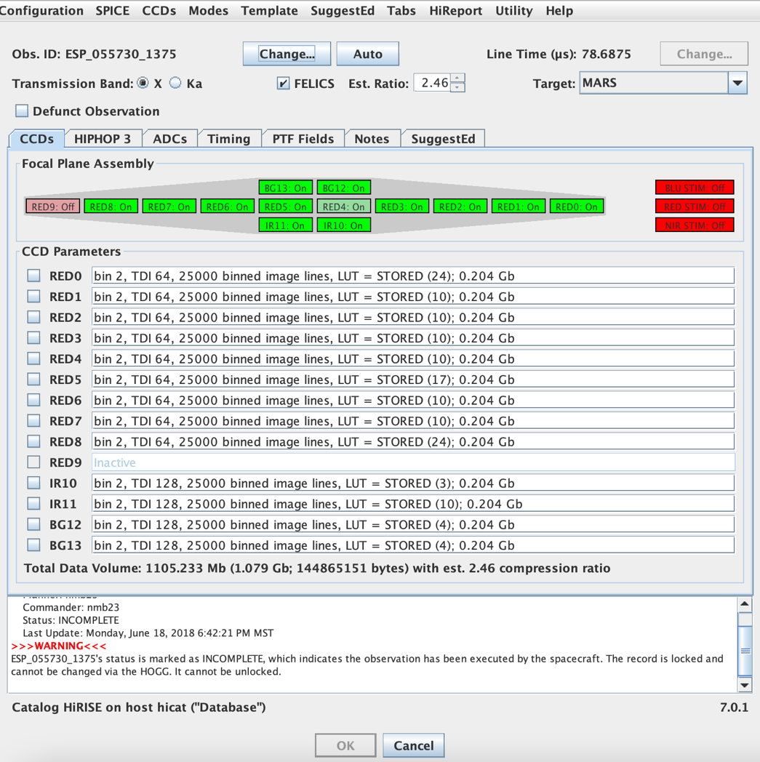
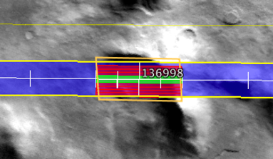
HiPlan and HiCommand
Both an application (extension of JMARS) and a suite of planning tools
Suite of planning tools primarily in Java
Many make use of MTT JSPICE
HiCommand produces HiRISE command files, uses HiPlan libraries
Notes:
GUI app is HiPlan, extra HiRISE info and The HOGG
Command line apps, main thing is SPICE

Slide 8
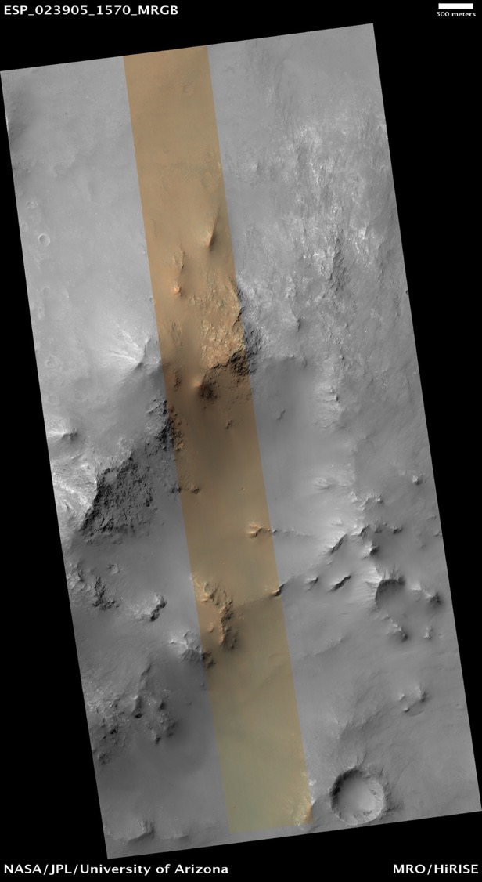
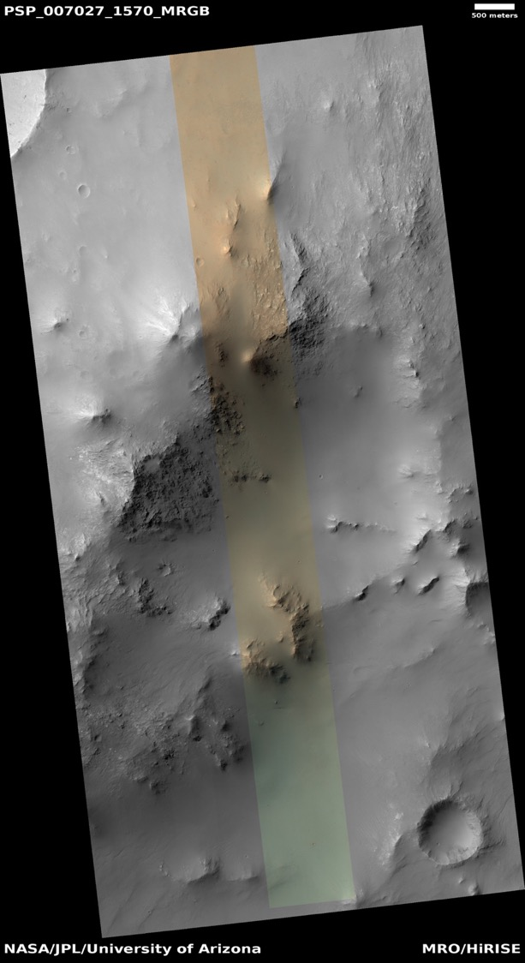
RED9 anomaly
In August of 2011, HiRISE entered safe mode when a component failed to respond to commands
Review of past telemetry showed “warning signs” – bifurcated currents in electronics telemetry
Problem CCD confirmed to be RED9
Solution? Don’t command RED9

Slide 9
Planning and commanding without RED9
# Inactive_CCDS -
# HiCommand uses the list of inactive CCDs to prevent a command file from
# commanding CCDs that are inactive; a CCD is inactive if it is currently
# switched to the opposite side from the active side.
#
# NOTE: List the inactive CCDs by CCD name (e.g., RED9), not by CPMM number.
Inactive_CCDs = { RED9 }
Notes:
“Don’t command RED9”
- manual – bad
- brute force – not ideal
- single source of truth – good for accuracy, good for operators

Slide 10
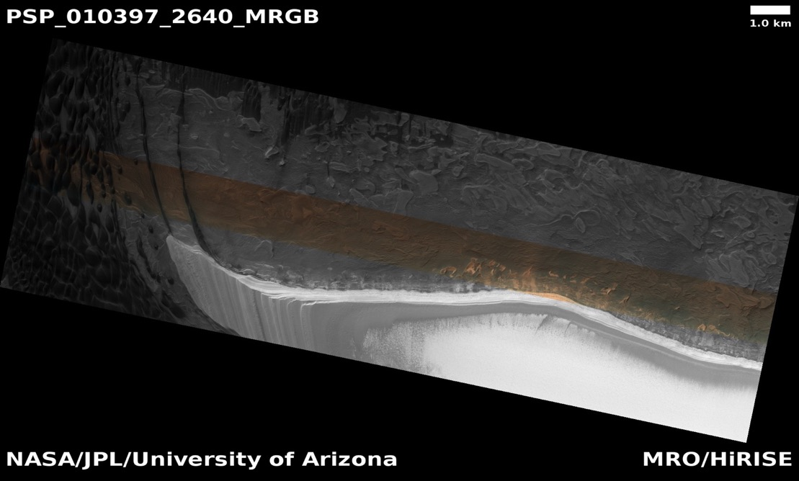
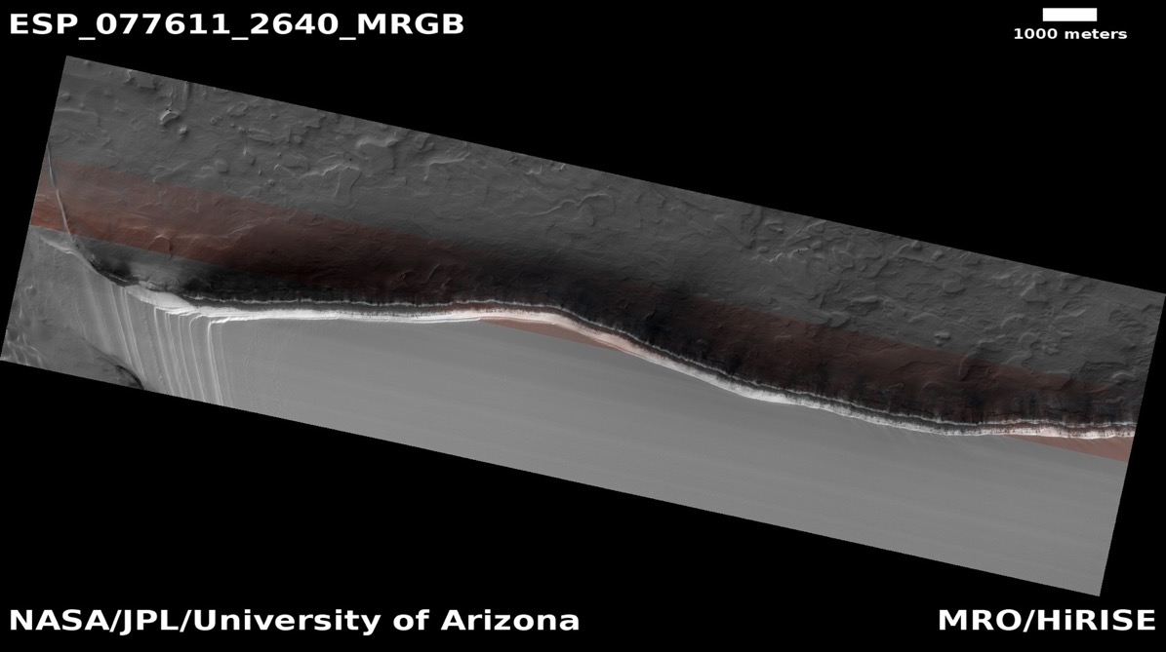
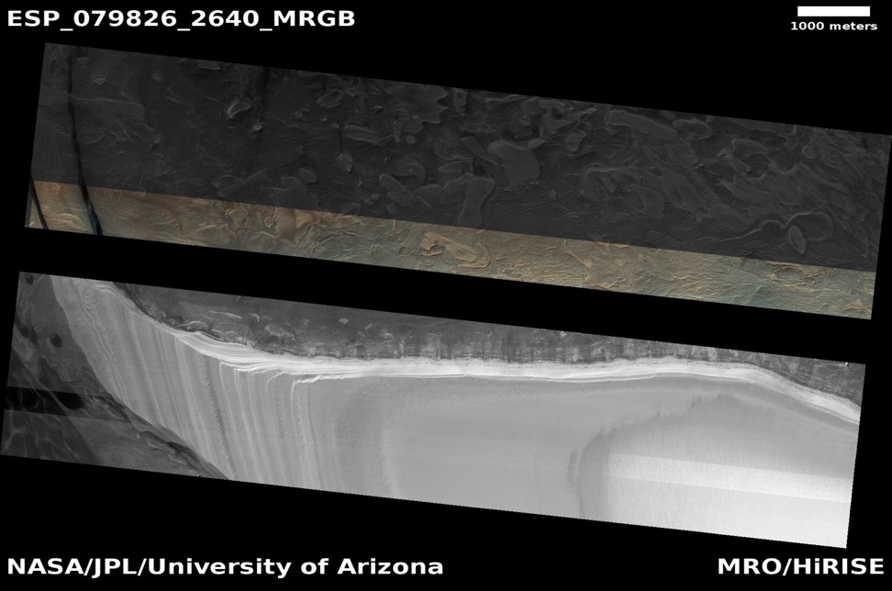
RED4 anomaly
In March of 2023, similar “warning signs” appearing with cold images
Telemetry does not indicate which CCD might be the cause
HiRISE safe mode entry due to failure of RED4 on July 14, 2023
Lessons learned from the loss of RED9 meant rapid return to imaging
RED4 is in the center of the array – images now gapped

Slide 11
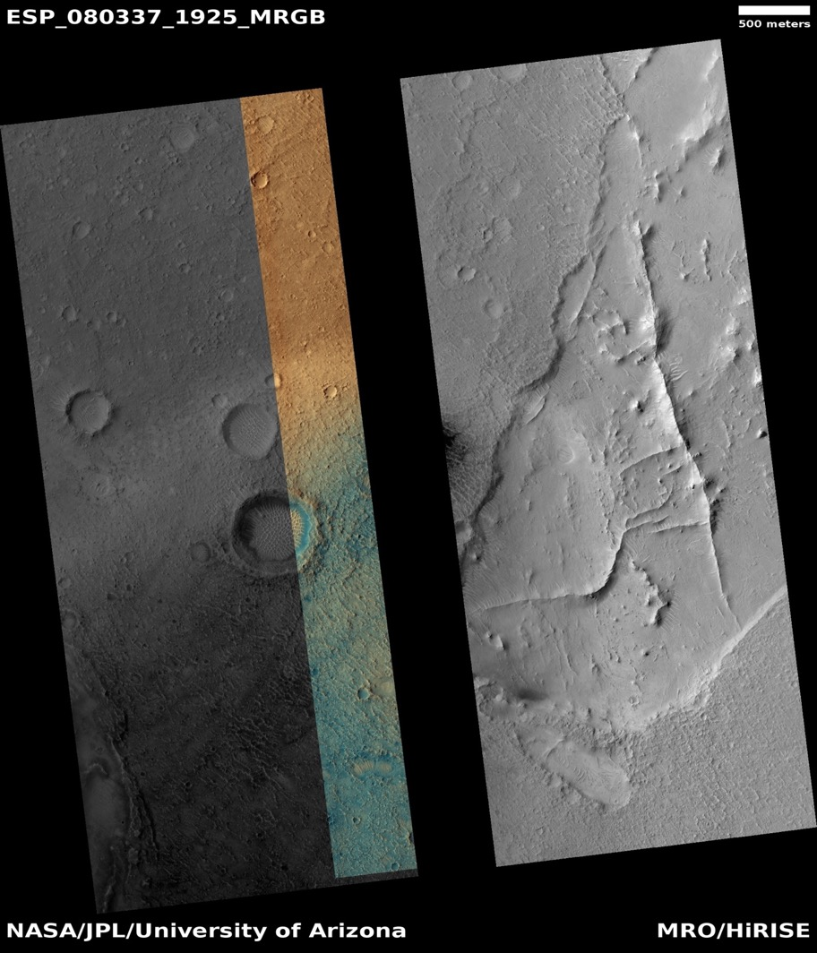
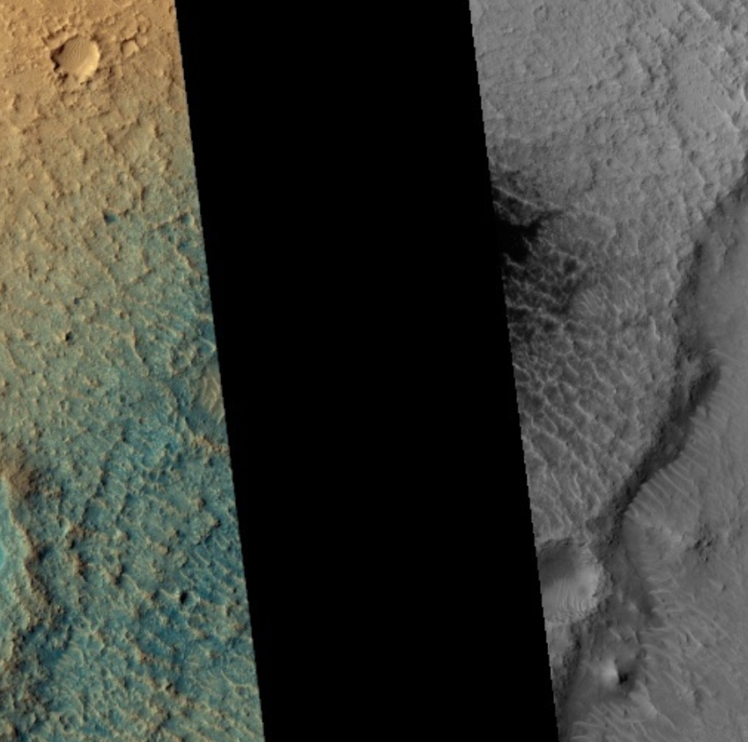
Target centers after loss of RED4
HiRISE boresight is between RED4 and RED5
The gap cuts through the center of whatever is targeted
Small features usually placed in the center of targets
Without adjustment, feature of interest can be lost
Adjust centers, but how?
POSSIBLY A CRATER

Slide 12
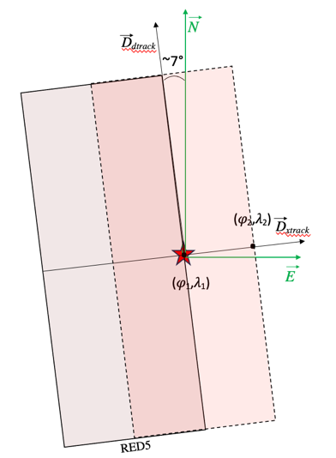
How to apply an offset?
D_{dtrack}
N
Notes:
Suggestion database not to be adjusted wholesale
Not appropriate for every target
Not straightforward to accomplish
We hope RED4 may be usable at higher temperatures
Adjusting by hand is not feasible
We submit hundreds of targets
Large opportunity for error
Automated process highly desirable
Delta roll = 0.5 CCD, .001 rad

Slide 13
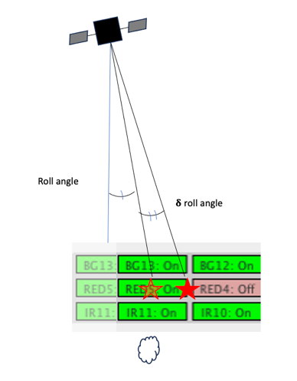
Apply_Targeting_Offsets
Usually: (lon, lat) -> ET, roll
In this case: ET, roll -> (lon, lat)
Alter only the sequence record contents
Make use of existing infrastructure
Apply_Targeting_Offset
[[--configuration] <HiPlan>.conf]
[--state] <state>.nk
[--offset <offset_size>]
[--all-records]
[[--output] <output>.ptf]
<input>.ptf
Notes:
Delta roll = 0.5 CCD, .001 rad
We have HiPlan tools that make use of MTT to do the former
Write a HiPlan tool that makes use of MTT to do the latter

Slide 14
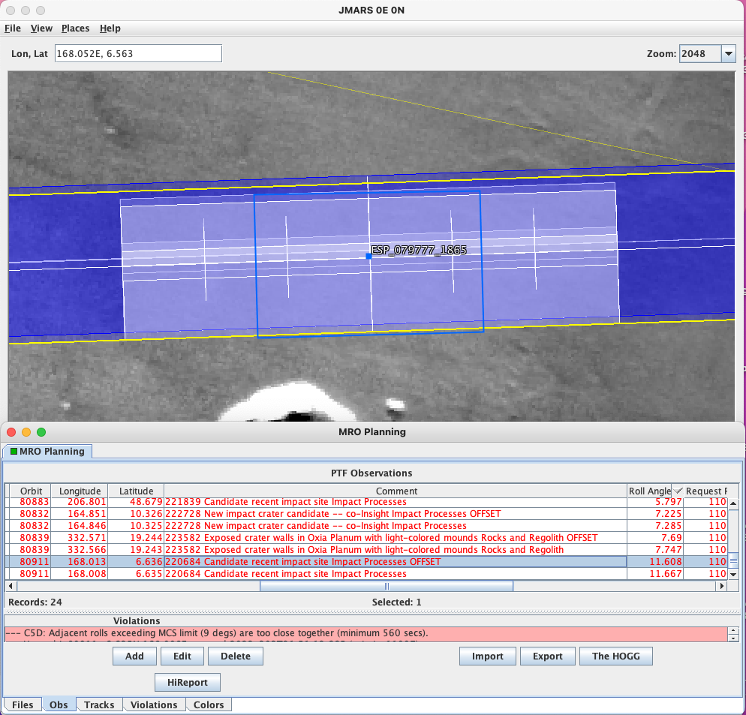
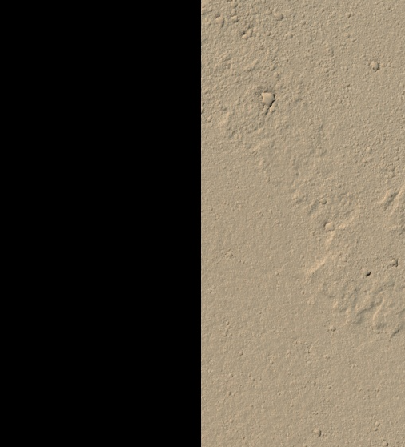
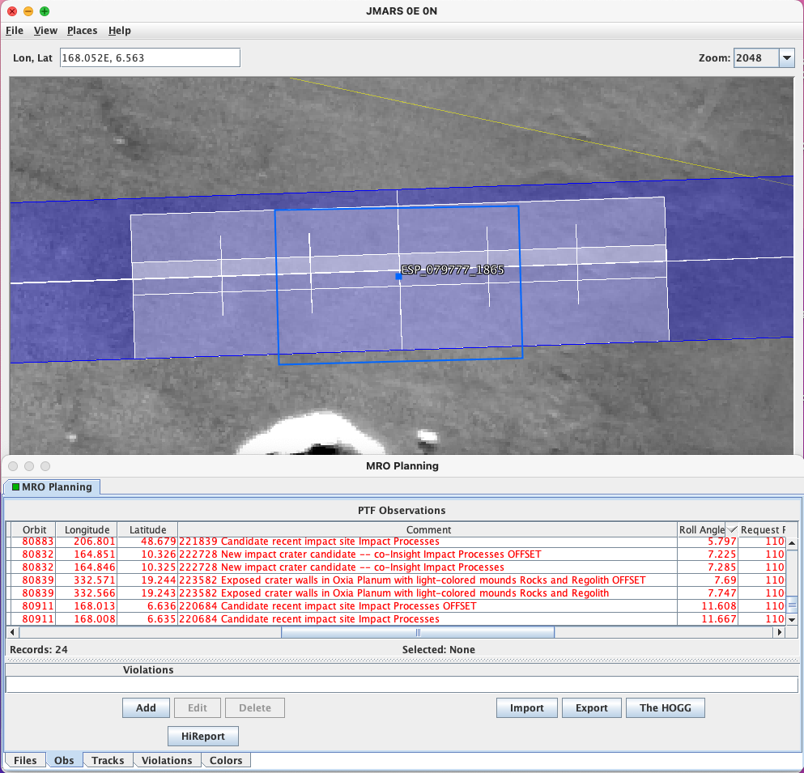
Apply_Targeting_Offsets
ESP_080911_1865
D_{dtrack}
N
ESP_079777_1865

Slide 15
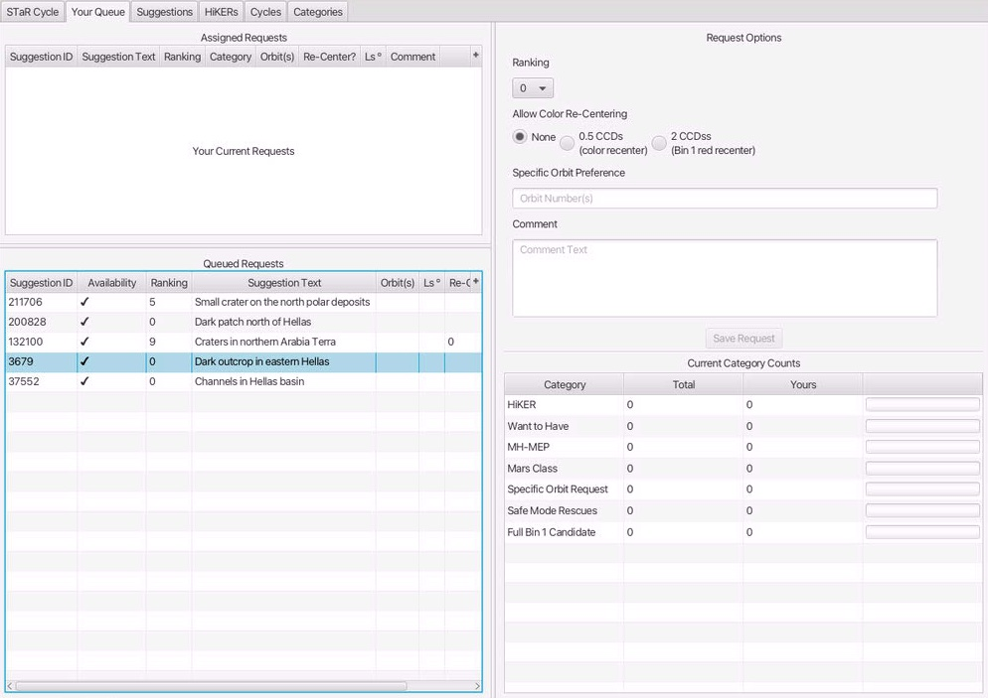
Can we do more with offsets?
STaR – Special Target Requests puts offset information into our database
What if larger moves are necessary in the future?
What if other constraints argue for a different offset?
What if the loss of RED4 is not permanent/not in all cases?

Slide 16
Conclusions
Two planning sequences after the loss of RED4, Apply_Targeting_Offsets was in use to modify target centering.
Software infrastructure gives us a “deep bench” of tools to use, modify and create to respond to anomalies as they arise
Frequent communication between science, operations, and development teams leads to better tools
The HiRISE team is well-equipped to respond to similar challenges in future.

Slide 17
